Slide 1
INX Incontrol mobile v5 Incontrol mobile user guide
INX Incontrol mobile v5

Slide 2
INX Incontrol mobile v5
Incontrol mobile user guide

Slide 3
REGISTRATION

Slide 4
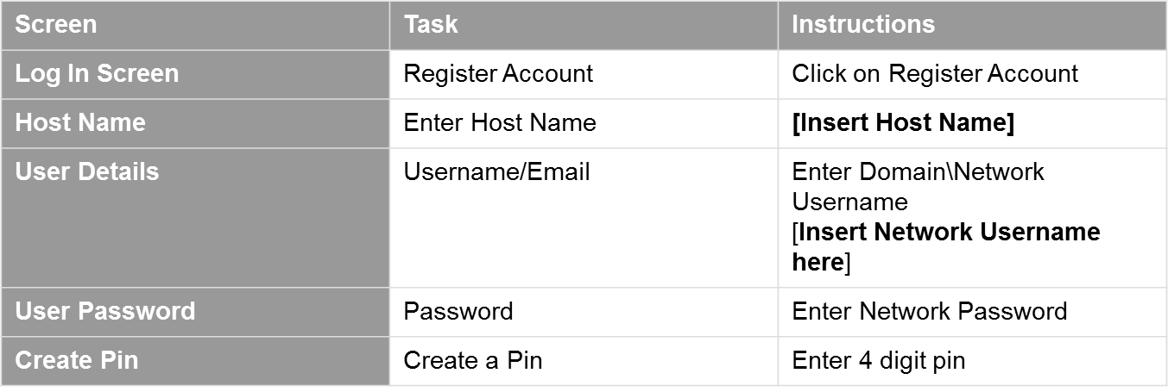
Registration Instructions
InControl Security User
inx-mobile.igo.com.au
IGO\firstname.lastname

Slide 5
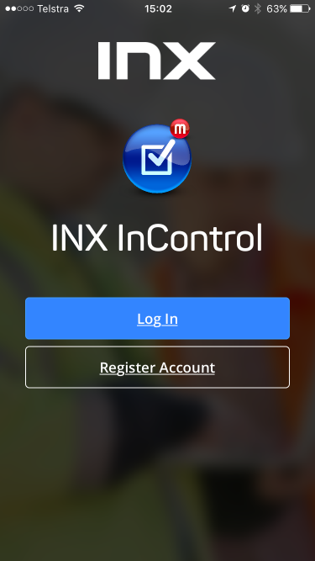
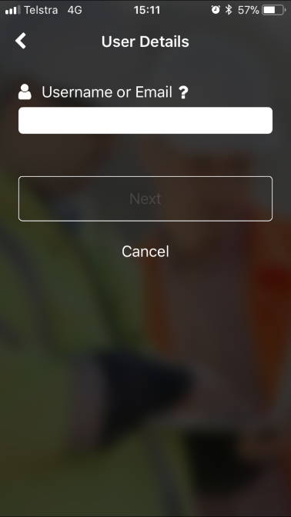
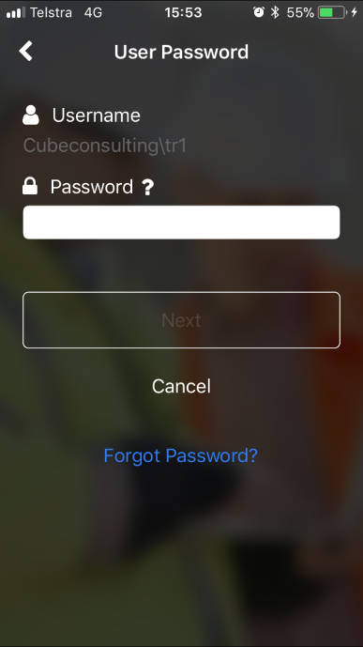
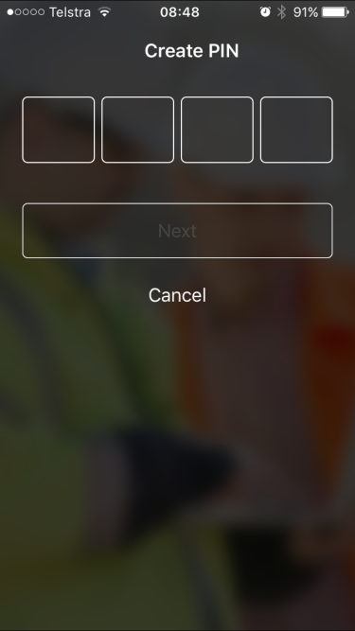
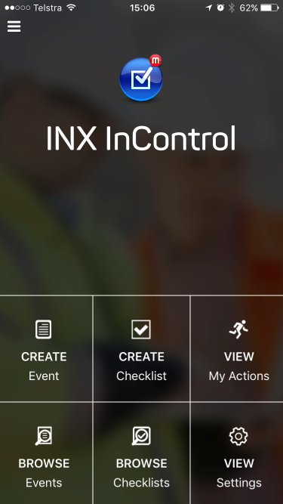
Screen Flow

Slide 6
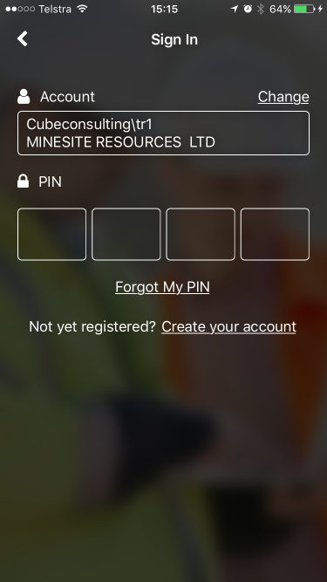
Log In Instructions
Click Log in,
Select User – Click on ‘Change’ if default is incorrect,
Add Pin,
Click on ‘Forgot Pin’ to reset as required.

Slide 7
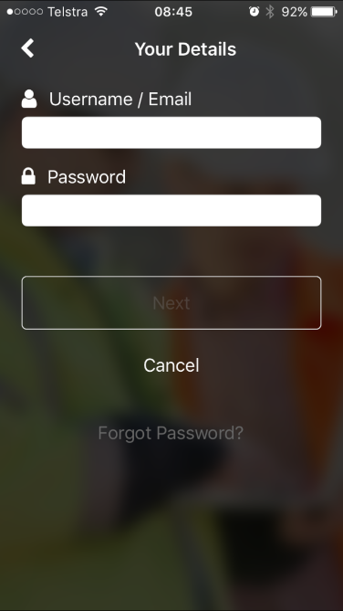
Forgot Pin
Click ‘Forgot My Pin’
Enter Username/Email
Add Password
Create NEW Pin

Slide 8
HOME PAGE

Slide 9
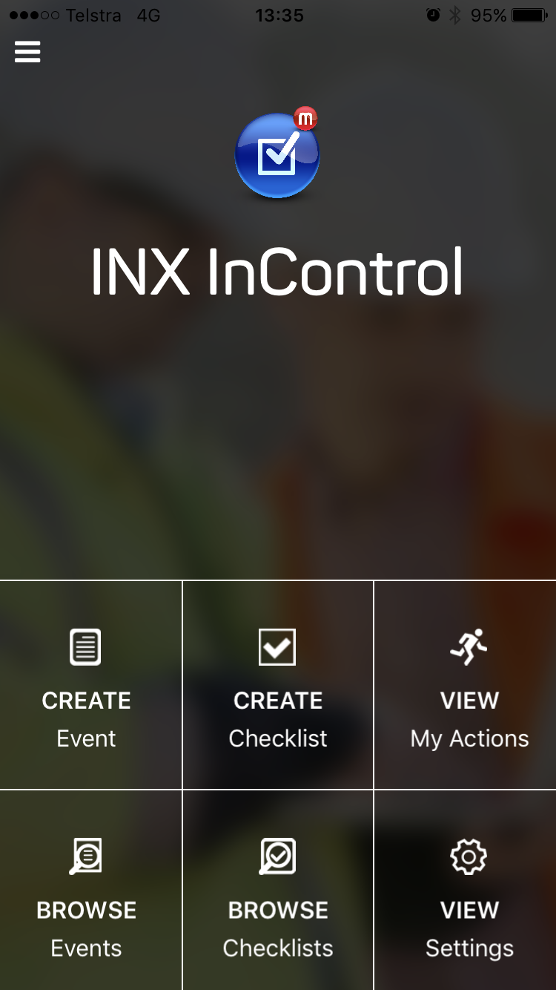
Home Page
Click on one of the tiles to initiate a process or click on the menu icon at the top of the screen to search for other options

Slide 10
MENU

Slide 11
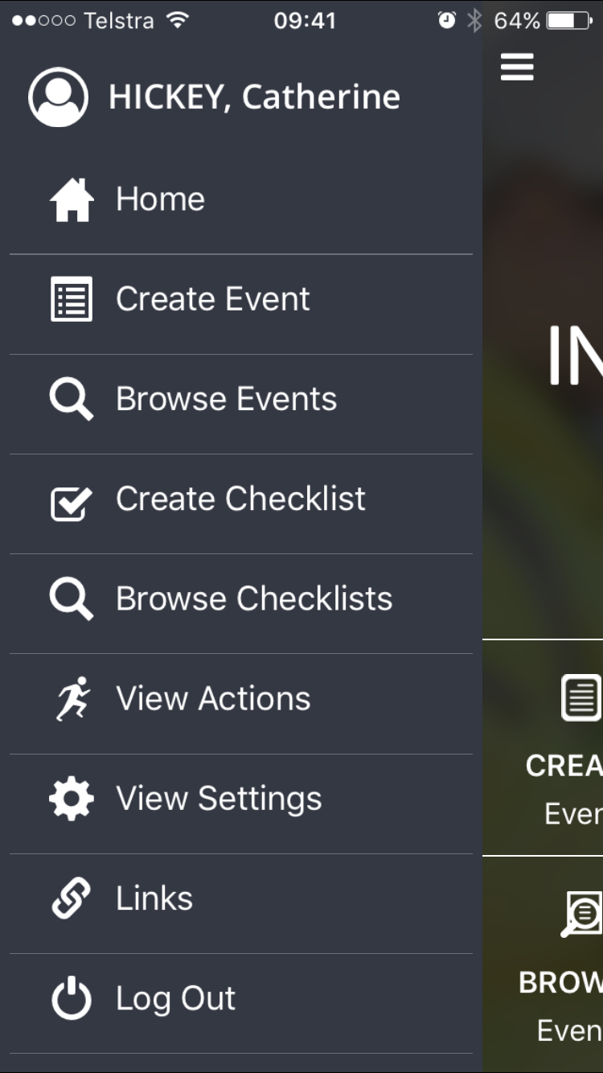
Menu
Select
Create Event
Browse Events
Create Checklists
Browse Checklists
View Actions
View Settings
Links
Log Out

Slide 12
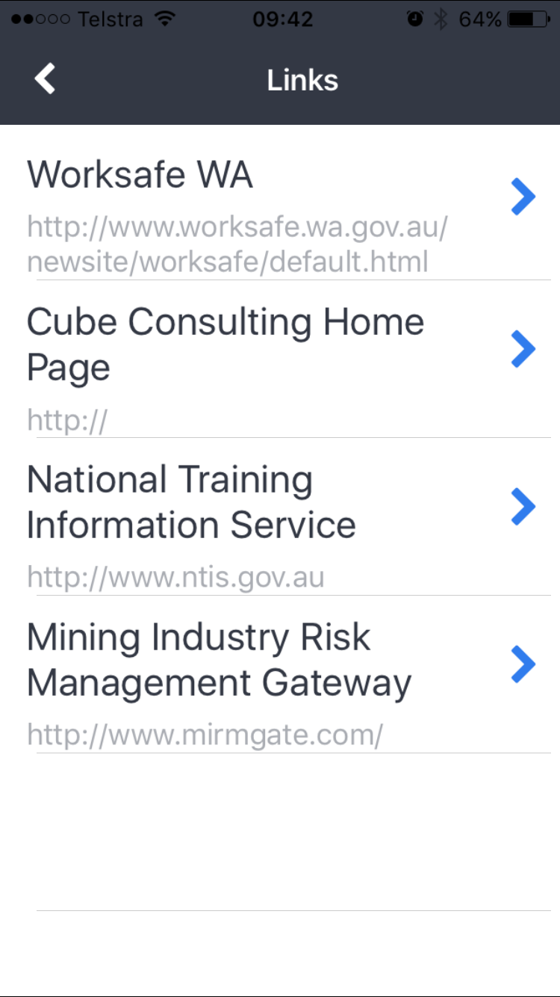
Links
Links available on the InControl Home Page will be visible in the links section from the App Menu.

Slide 13
CREATE EVENT

Slide 14
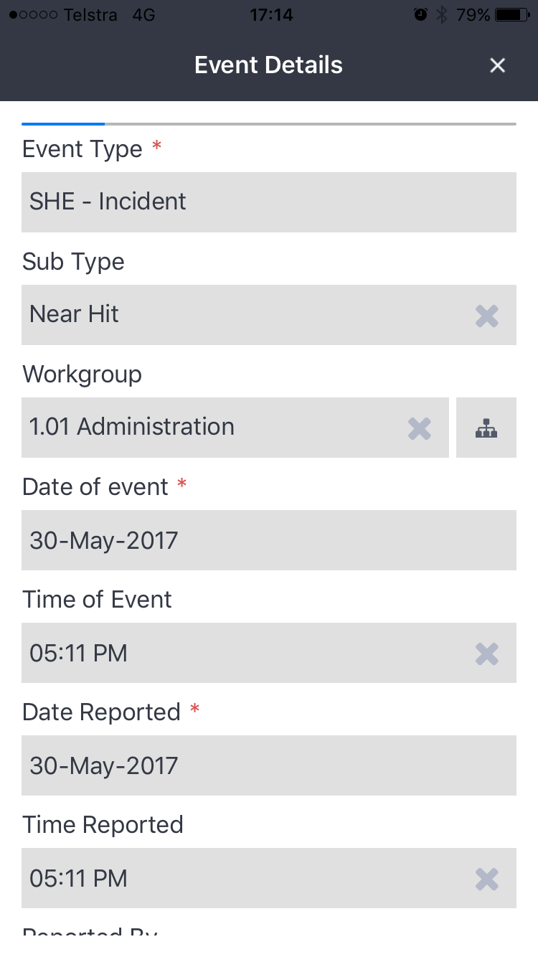
Event Details
Indicates progress of an event
Capture
Event Type
Event Sub Type
Workgroup
Date of Event
Time of Event
Date Reported
Time Reported
Reported By
Name (if not in list)
Reported To
Name (if not in list)
Responsible Organisation
Clears selection
Navigates to selector
Mandatory Field
Defaults to date and time of device

Slide 15
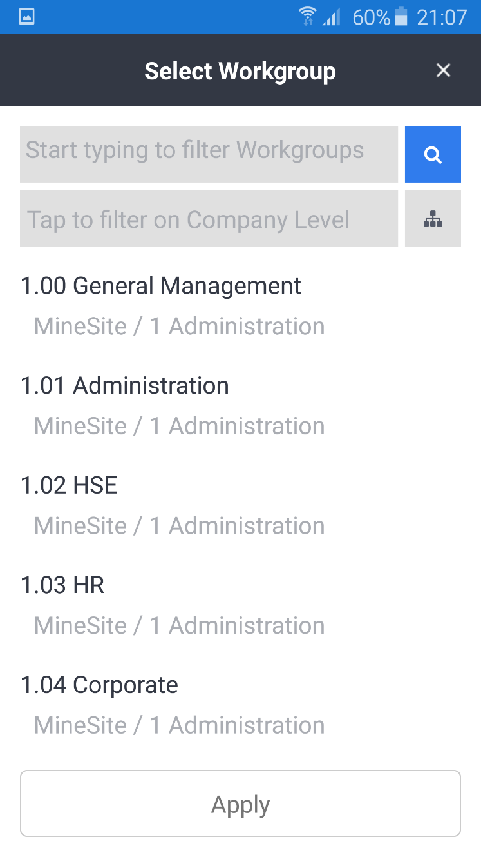
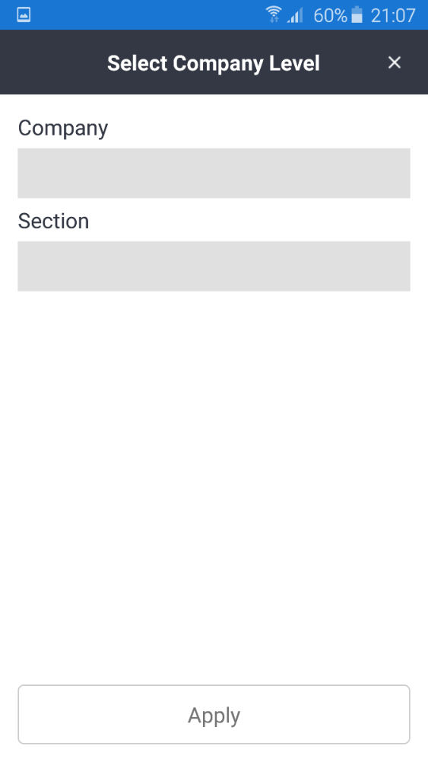
Workgroup Selector
Search
Scroll
Filter

Slide 16
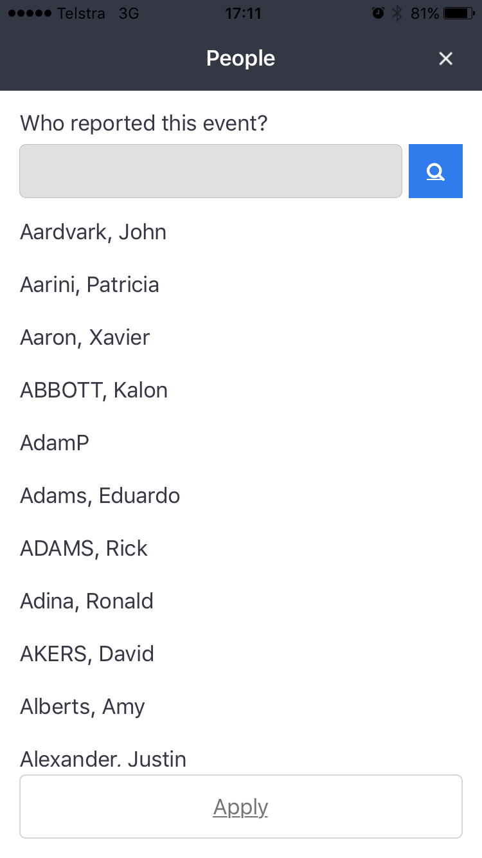
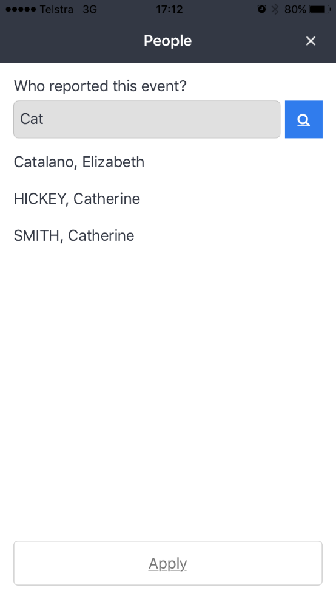
People Selector
Scroll through the list of people or search using the search function at the top of the screen.
Click Apply to return back to the event screen.

Slide 17
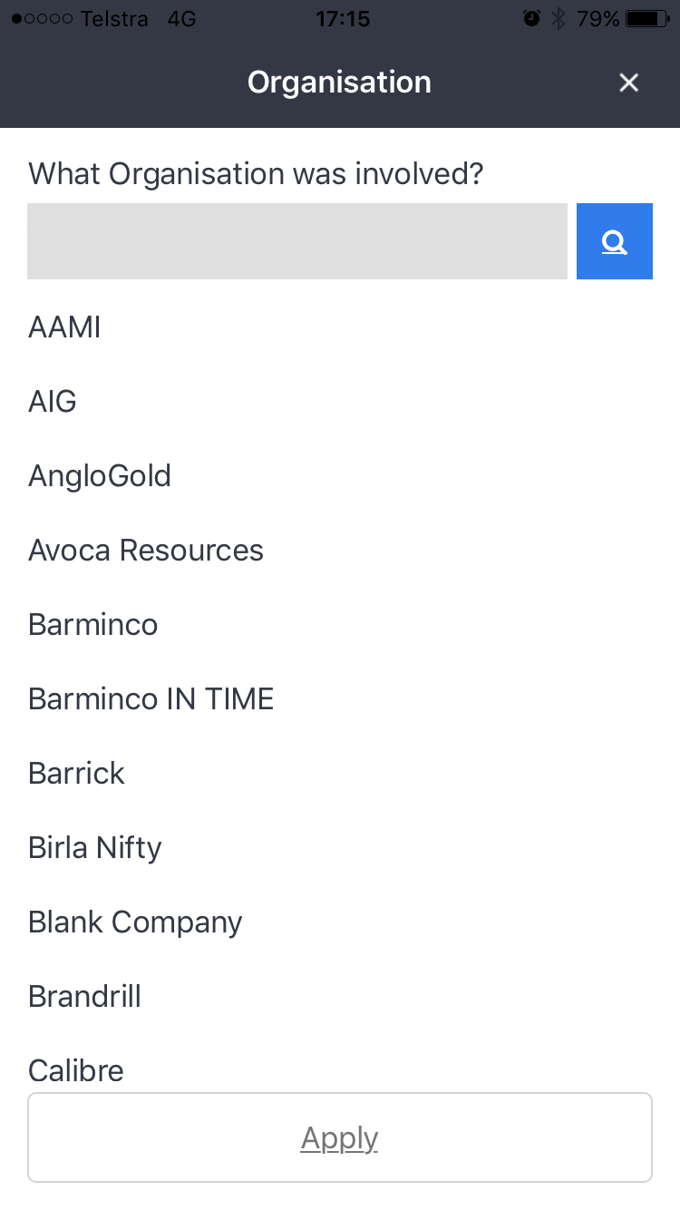
Organisational Selector
Scroll through the list of organisations or search using the search function at the top of the screen.
Click Apply to return back to the event screen.

Slide 18
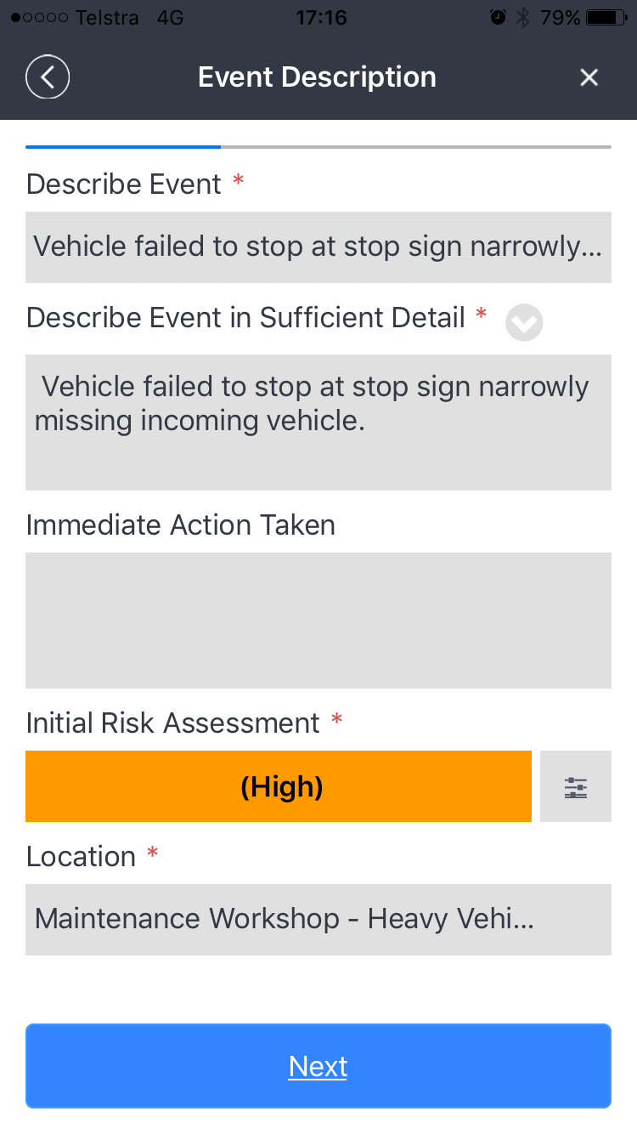
Event Description
Capture
Describe Event
Describe Event in Sufficient Detail
Immediate Action Taken
Initial Risk Assessment
Custom Fields
Checklist
Copies description
Only appear based on event configuration

Slide 19
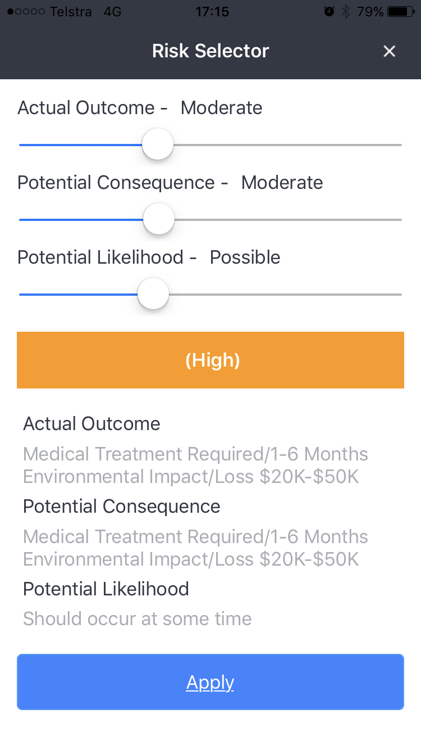
Risk Assessment Selector
Use your finger to slide the selector.
Risk descriptions are displayed at the bottom of the screen.
Select Apply to return to the event description.

Slide 20
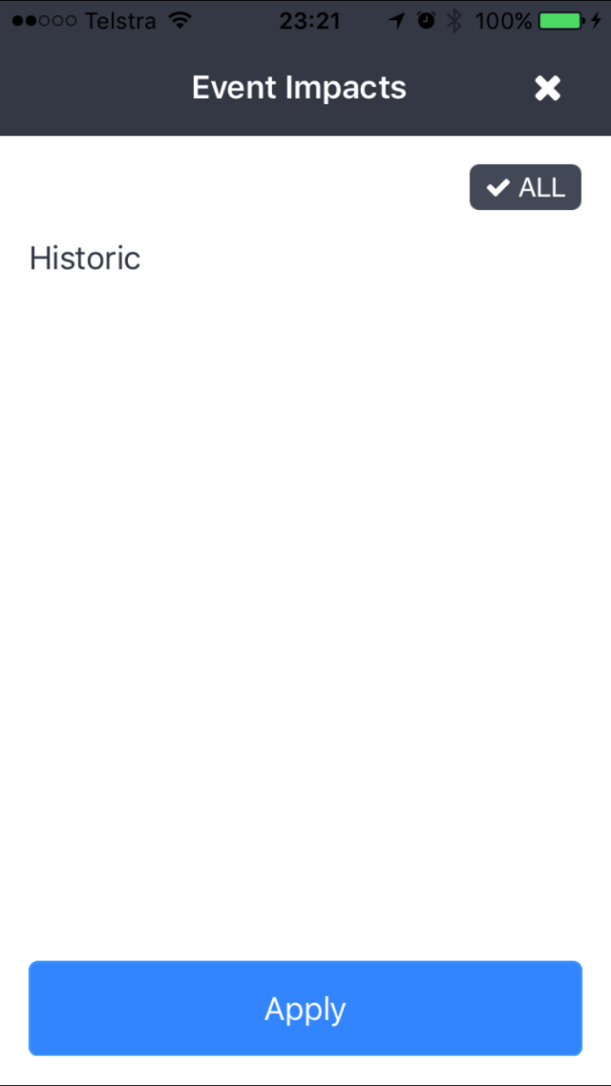
Impact Selector
Click on one or more impacts. Select apply to return back to the event description screen.

Slide 21
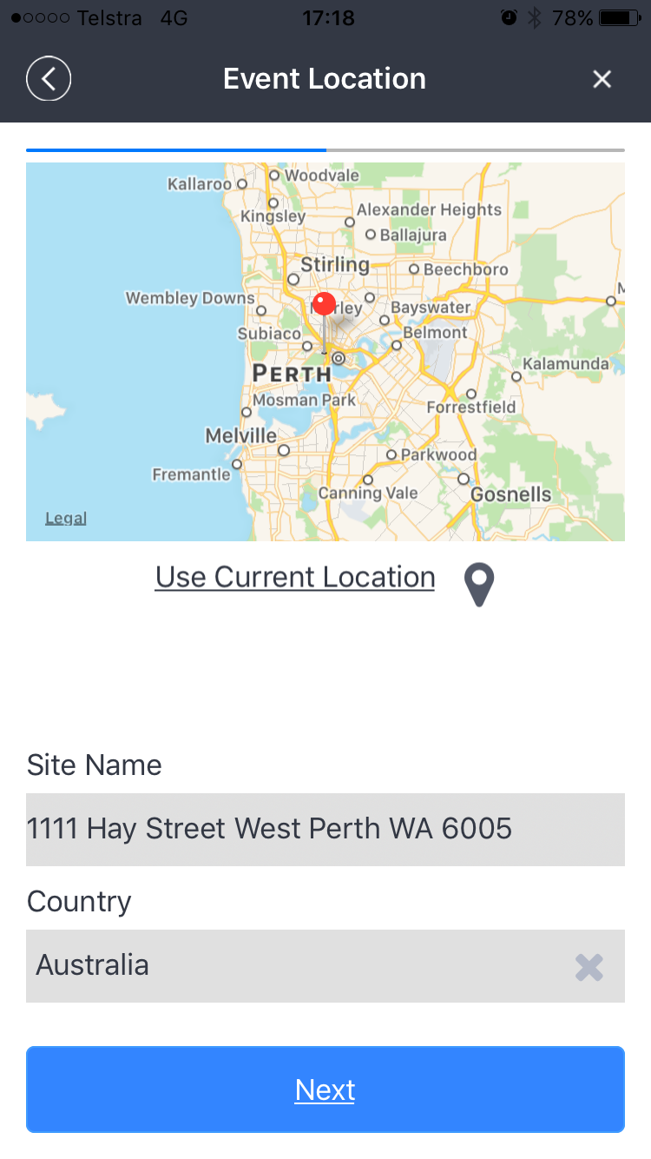
Event Location
Click on Use current location to return your location
Click on the map icon to manually select a location or move the map pin.

Slide 22
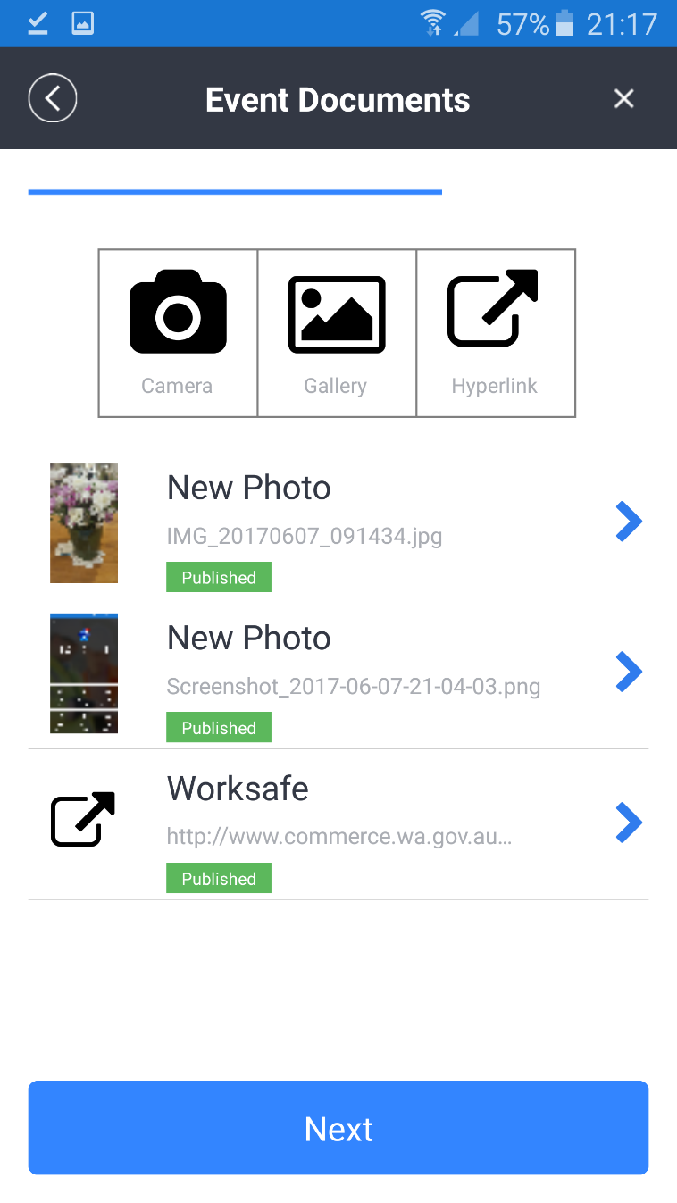
Event Documents
Take pictures using device camera
Add pictures already in your gallery
Add a hyperlink
Click on the blue arrow to edit the document
Click on the picture to view the image.

Slide 23
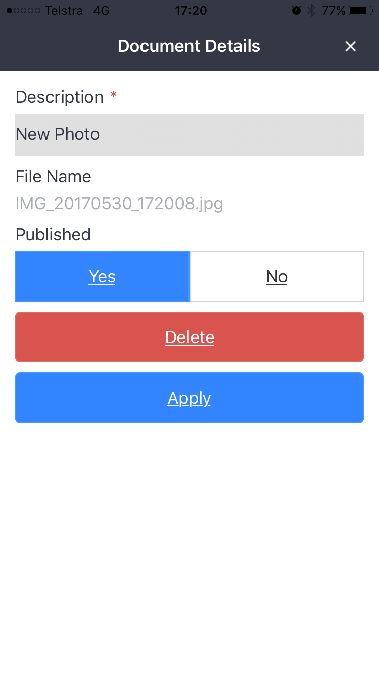
Document Details
Update the document description
Delete the document

Slide 24
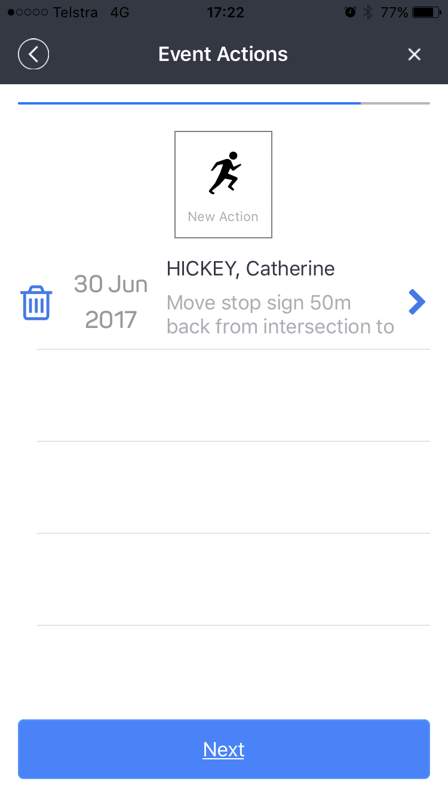
Event Actions
Click on new Action to add a new action
Click on the delete icon to remove action
Click on blue arrow to edit action

Slide 25
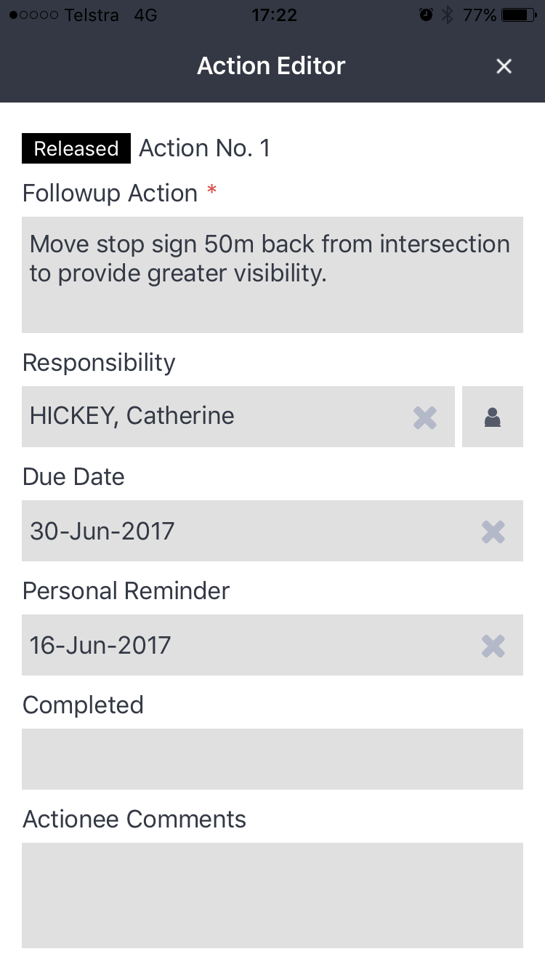
Action Editor
Cancels Action
Capture
Follow up Action
Responsibility
Due Date
Personal Reminder
Completed Date
Actionee Comments
Action Type
Control Class
Risk Assessment
Cost
Progress
Action Conditions
Action Documents
Navigates to person selector
Clears selection

Slide 26
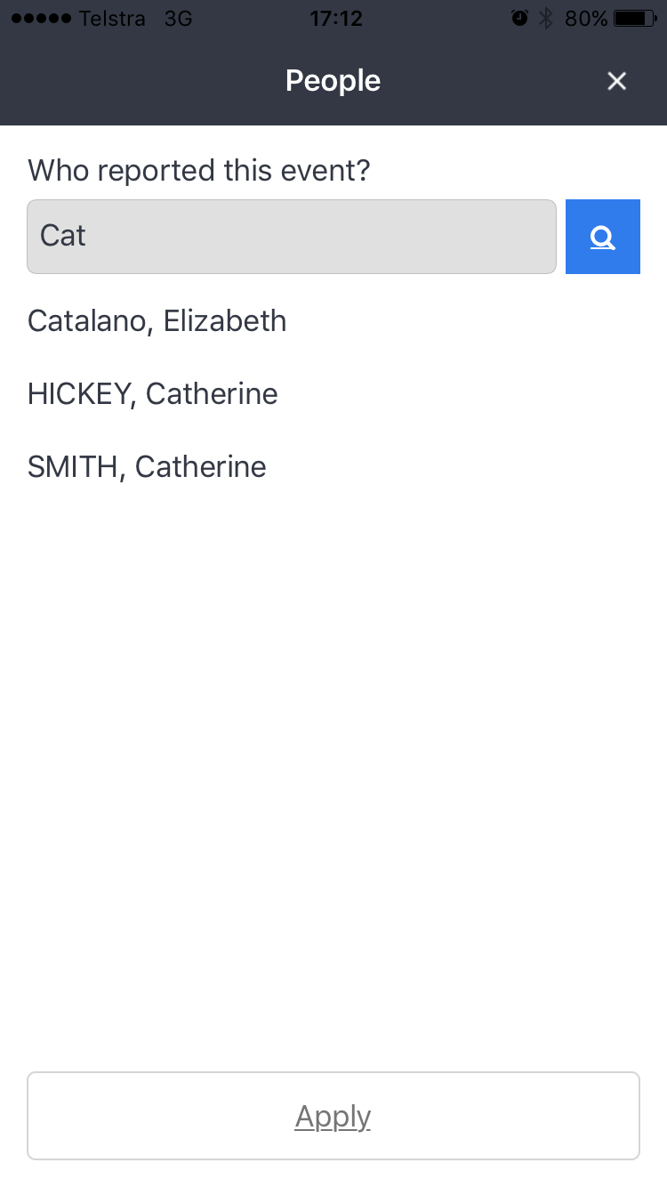
Person Selector
Scroll through the list of people or search using the search function at the top of the screen.
Click Apply to return back to the action editor.

Slide 27
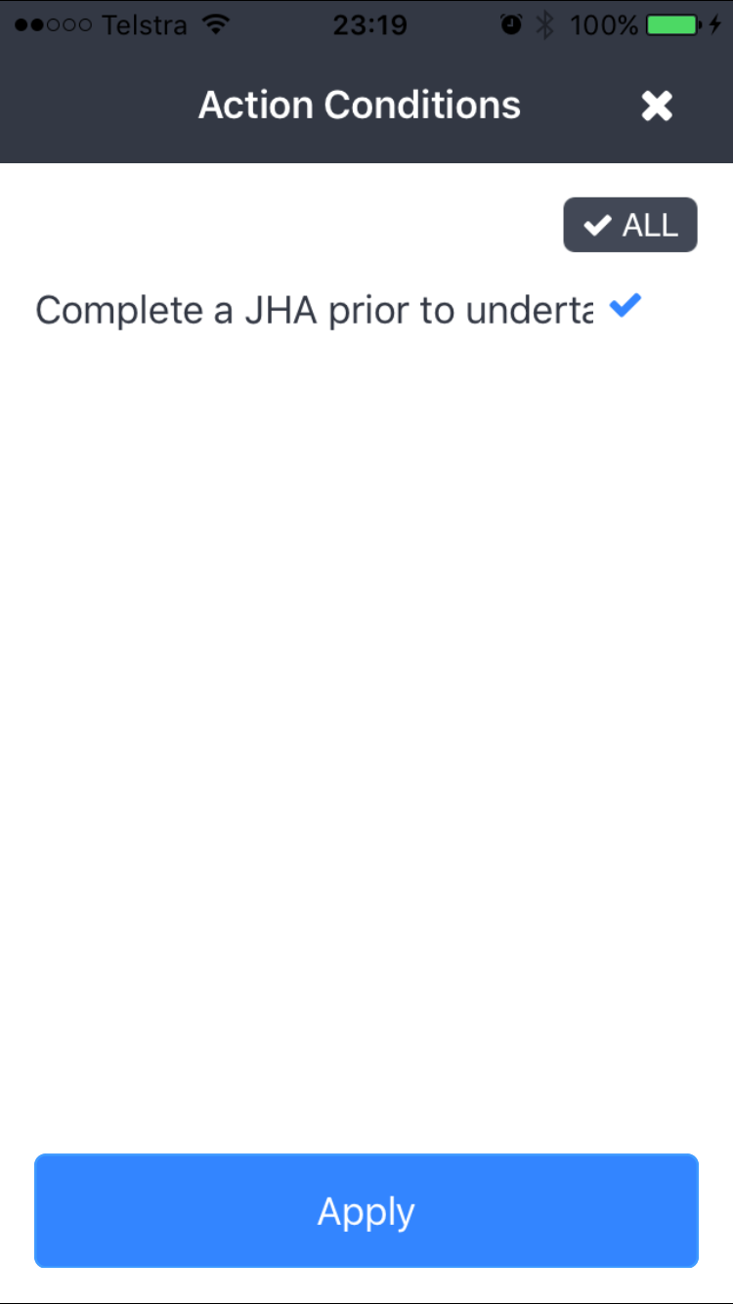
Action Condition Selector
Click on one or more action conditions. Select apply to return back to the action editor.

Slide 28
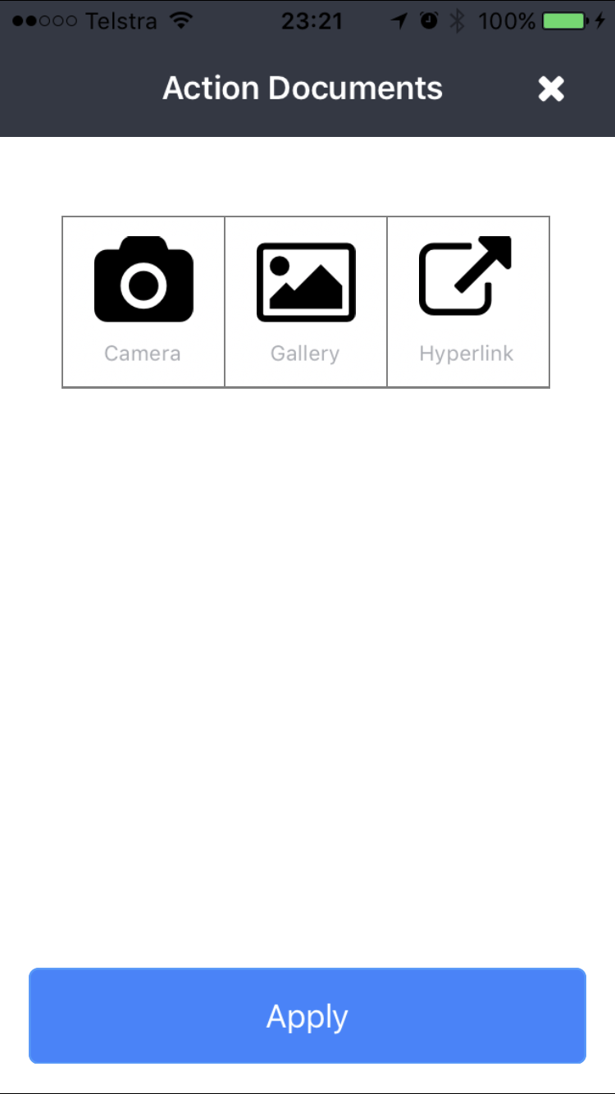
Action Documents
Take pictures using device camera
Add pictures already in your gallery
Add a hyperlink
Click on the blue arrow to edit the document
Click on the picture to view the image.

Slide 29
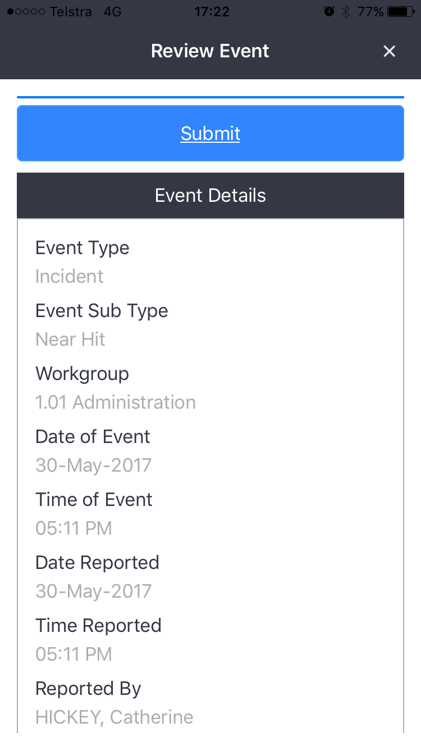
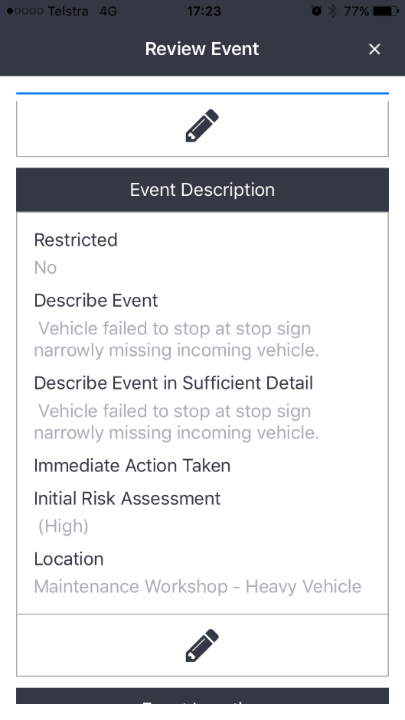
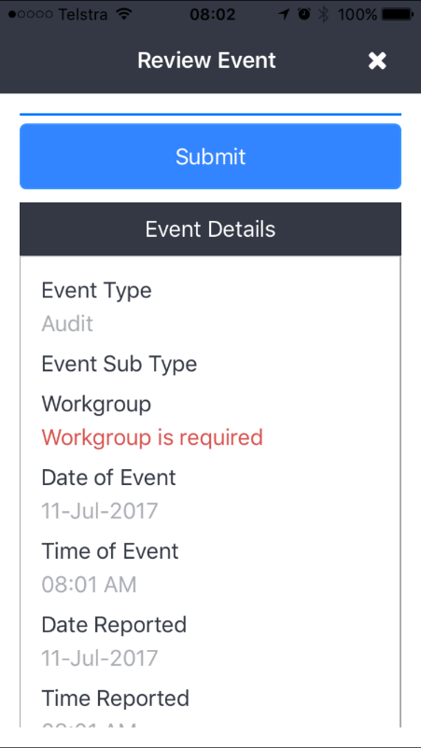
Review Event
Final Step before submission
Review all information entered for the app
Click on the pencil to edit information.
Click Submit to upload into InControl.
Fix any submission errors

Slide 30
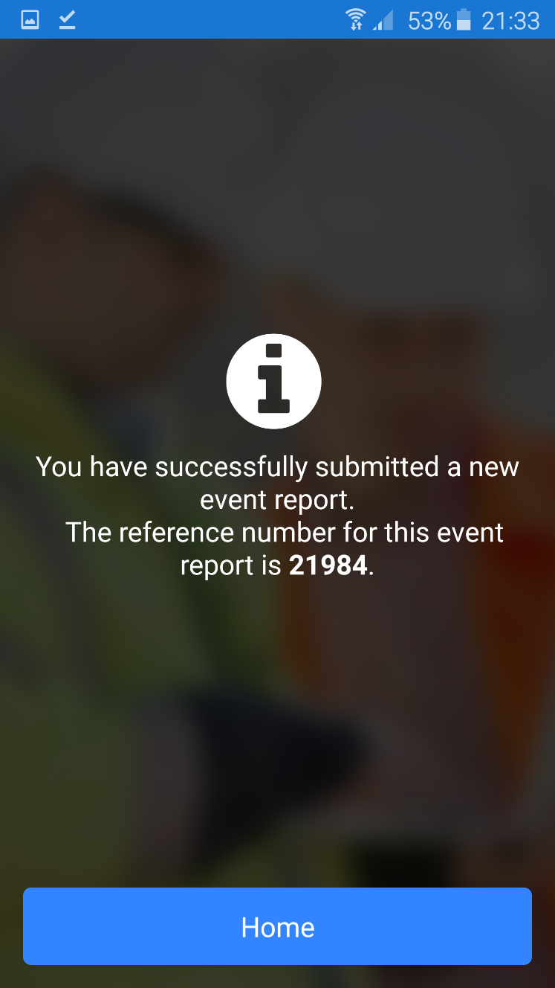
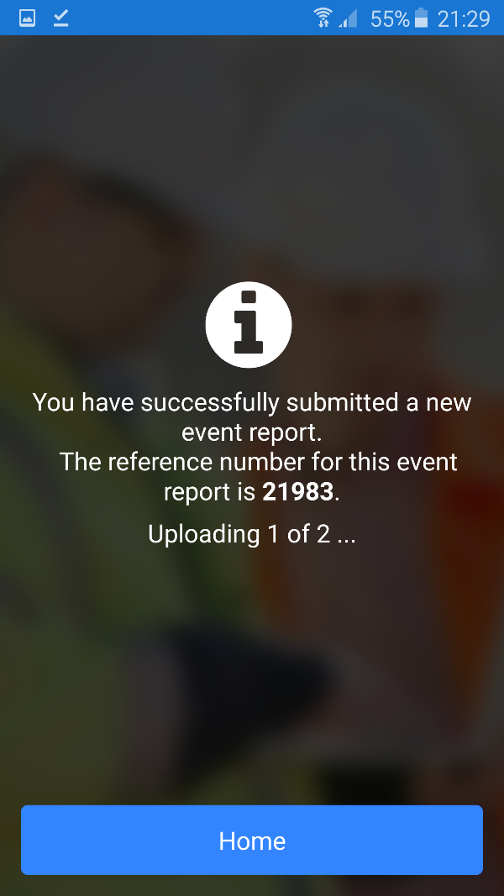
Submit Event
View event reference number.

Slide 31
BROWSE EVENT

Slide 32
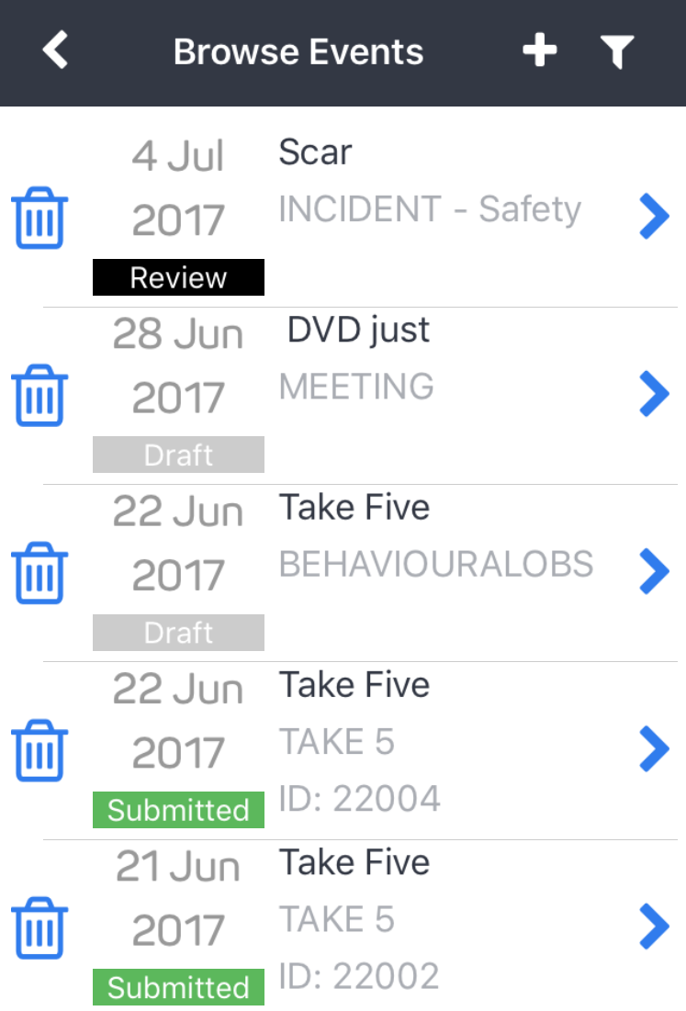
Event List
Filter
Browse all events submitted by the app.
Edit Draft and Review Events
Filter events in the list
Add a new event
Deleting events

Slide 33
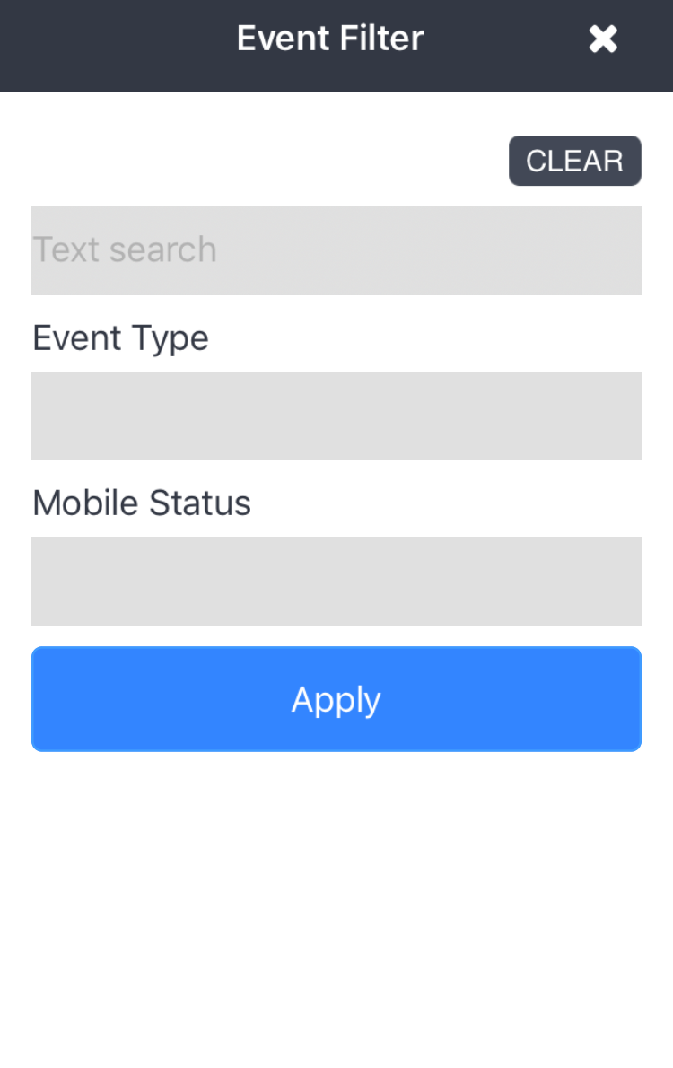
Event Filter
Filter events when there are a large number of events on the Browse Events screen

Slide 34
CREATE CHECKLIST

Slide 35
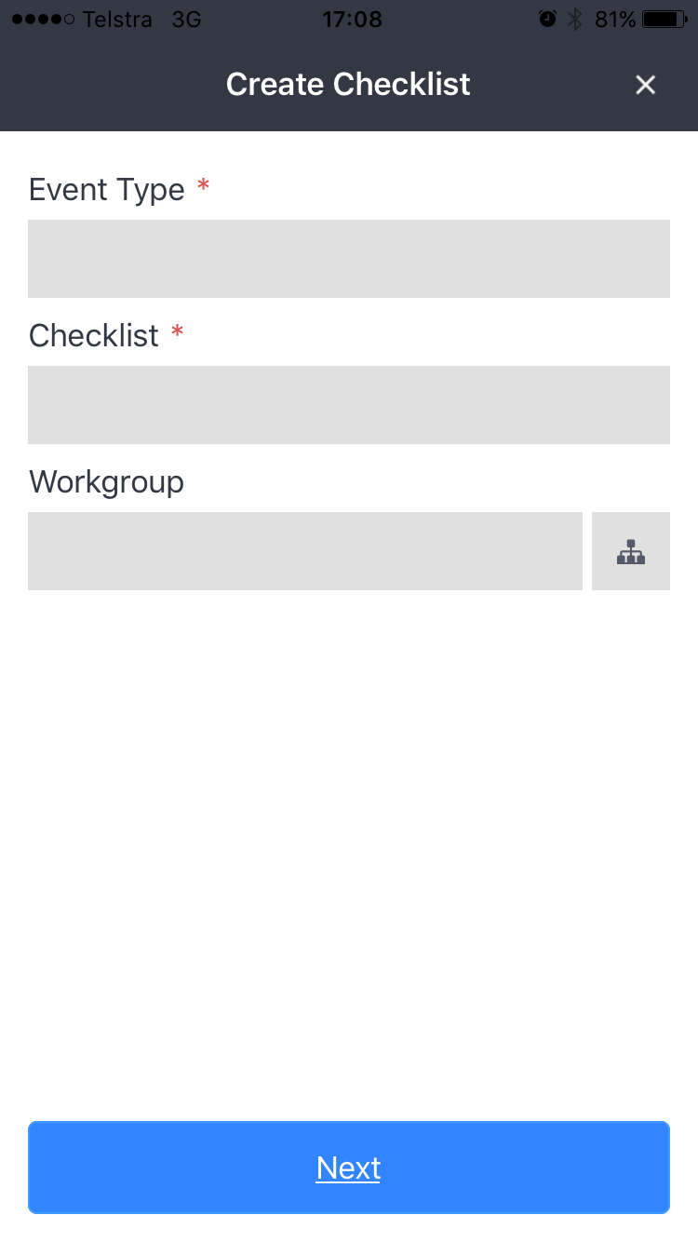
Create Checklist
Create a checklist without going through the event process
Enter mandatory information to submit checklist

Slide 36
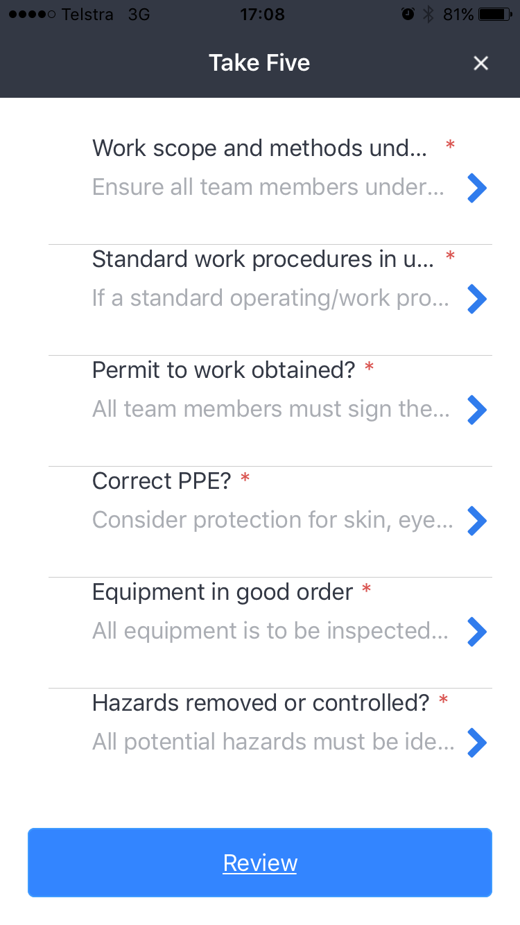
Checklist Summary
Lists all questions for the checklist.
* Indicates a mandatory questions.
Click on the blue arrow to answer a questions.
Click Review to submit checklist.

Slide 37
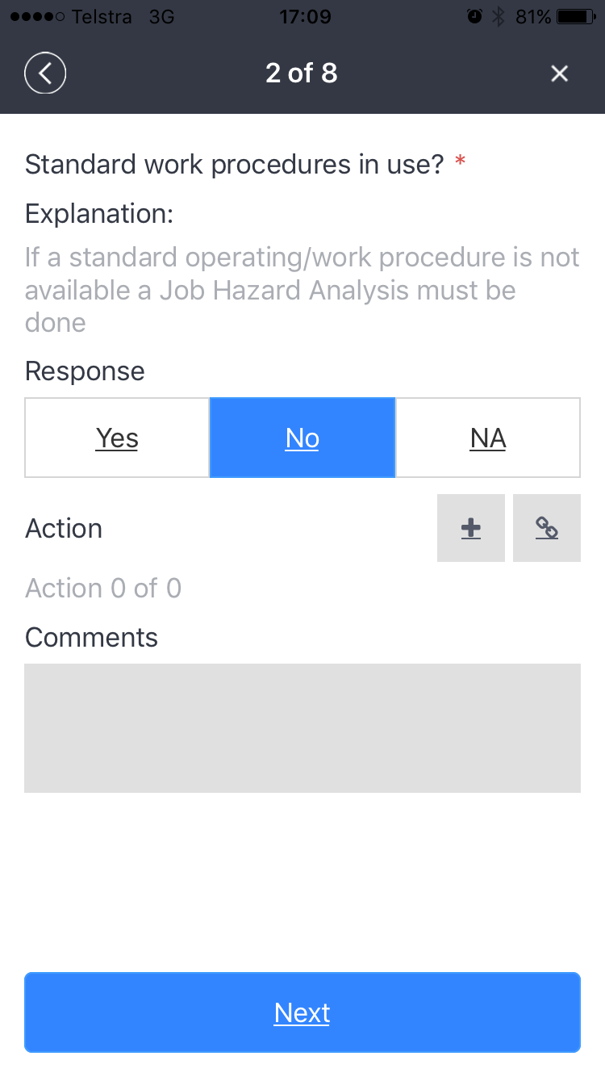
Checklist Item
Checklist Item:
Prompt
Explanation
Response
Add an Action/Documents
Add comments
Click next to move to the next question
Click the X to exit the checklist item
Click the < arrow to go back to the previous questions

Slide 38
BROWSE CHECKLIST

Slide 39
Checklist List
Browse all checklists submitted by the app.
Edit Draft checklists
Add a new checklist
Deleting checklist

Slide 40
MY ACTIONS

Slide 41
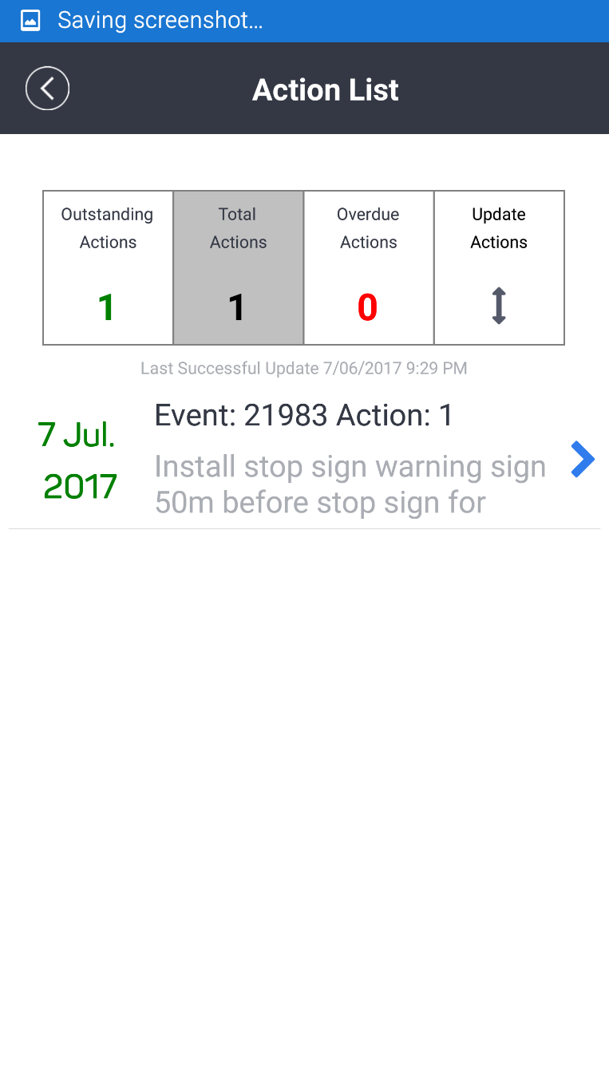
Action List
Click on the buttons at the top of the screen to filter actions
Click on Update Actions to sync with InControl
Click on the Blue arrow to edit the action in the action editor.

Slide 42
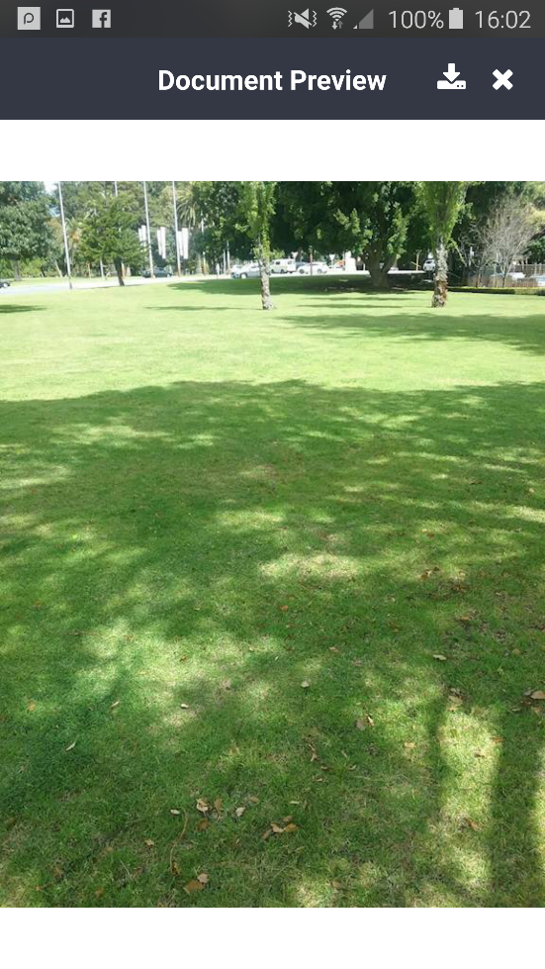
Action Documents
Take pictures using device camera
Add pictures already in your gallery
Add a hyperlink
Click on the blue arrow to edit the document
Click on the picture to view the image.
Download high resolution attachments from document preview

Slide 43
SETTINGS

Slide 44
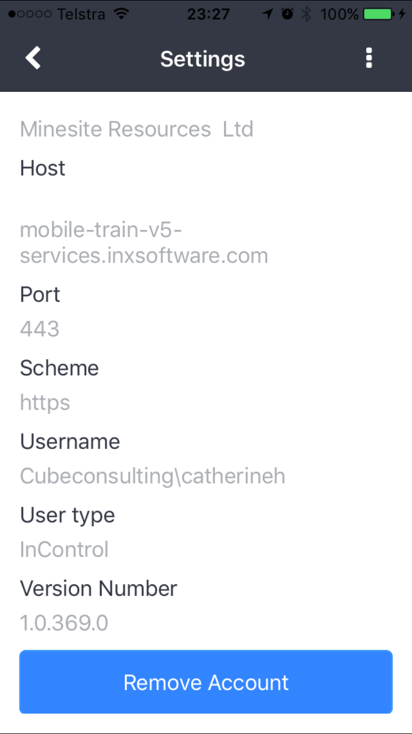
Settings
Displays the settings of the logged in user

